Slide 1
A&G Why, What, How? Dr John Patterson Associate Medical Director NHS GM (Oldham) SRO of GM Specialist Advice Project

Slide 2
WHY? Better conversations between 1° and 2° care
Mandated and Funded
Codable and billable
Make it work for everyone

Slide 3
WHAT?
GPs & other referrers using it to
Shorten patient journeys (reduces repeat appts)
Share Risk
General medical advice – DM, Haem, HRT, BP
(Trainees, AHPs)
Pre-referral work – patients caught in endless repeat tests etc

Slide 4
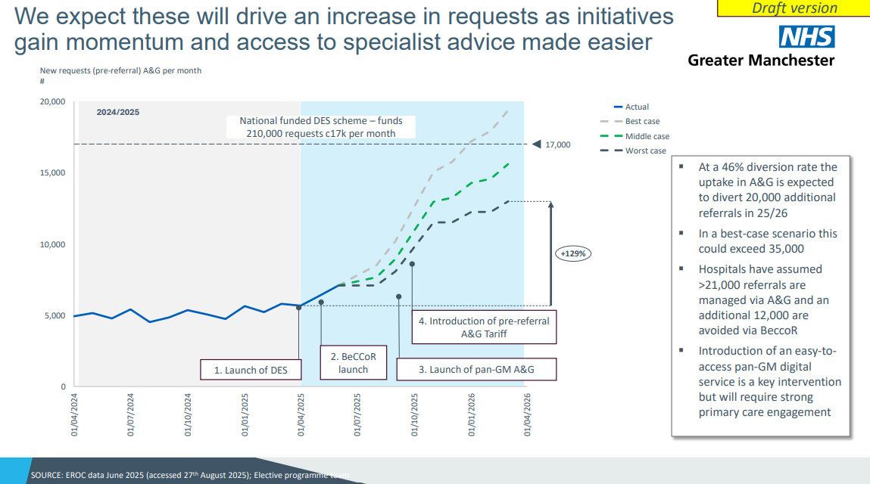
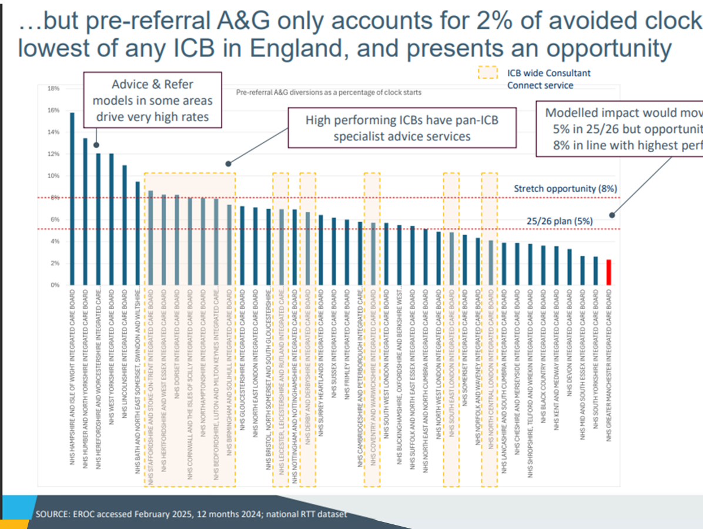

Slide 5
HOW?
Soon there will be 3 main ways
ALL A&G is codable and billable
Monthly retrospective submissions- high trust – dip sampling
(12 day window) (one claim per patient per issue)
OK to say no and go back or go straight to referral route
3 main types fo A&G
eRS
Local innovation schemes
GM wide digital tool linked to ‘national spine’ of advice

Slide 6
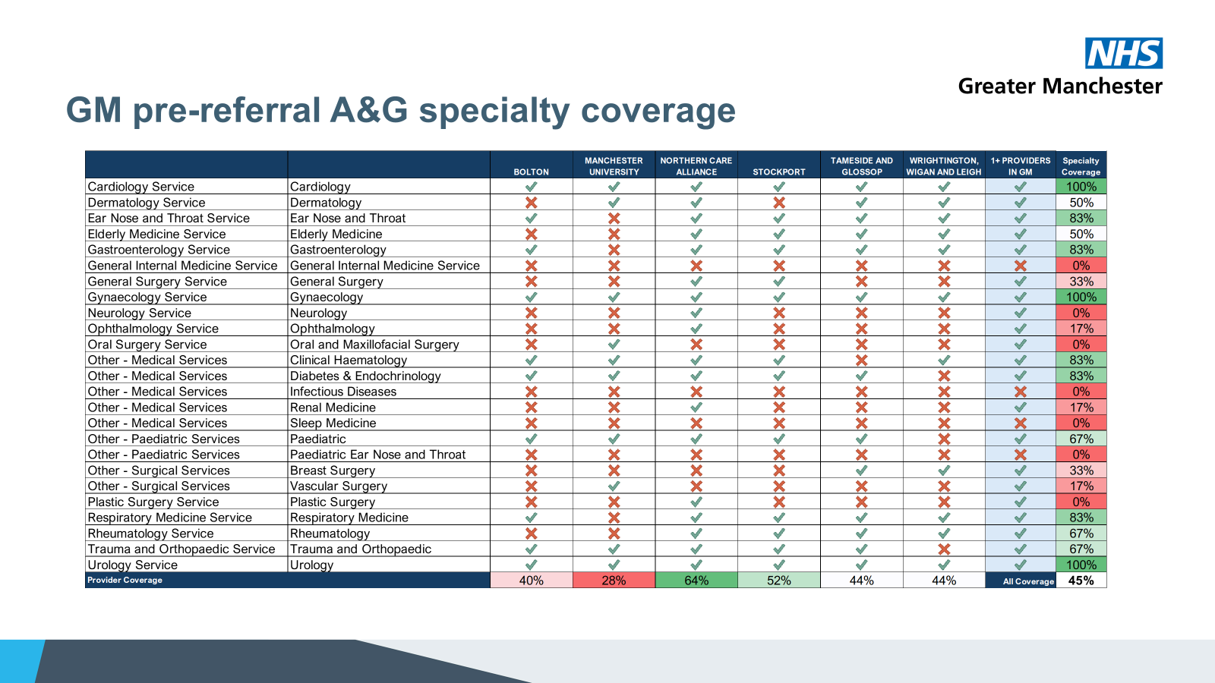
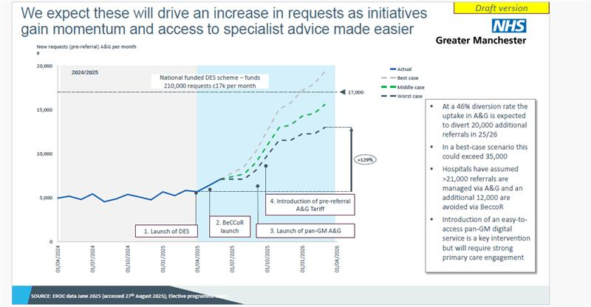
Traditional eRS - emailed A&G system

Slide 7

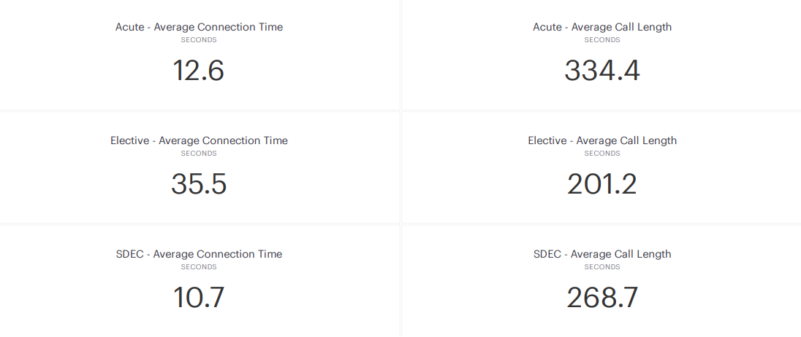
We can download and register on the App from today (1/10/2025) BUT do NOT use until DPIA in place

Slide 8
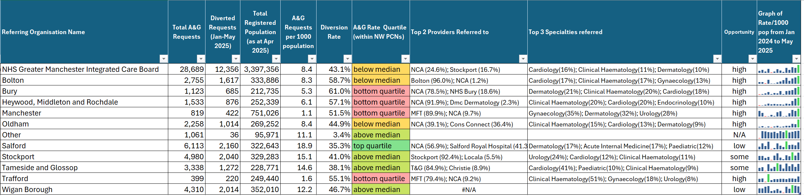
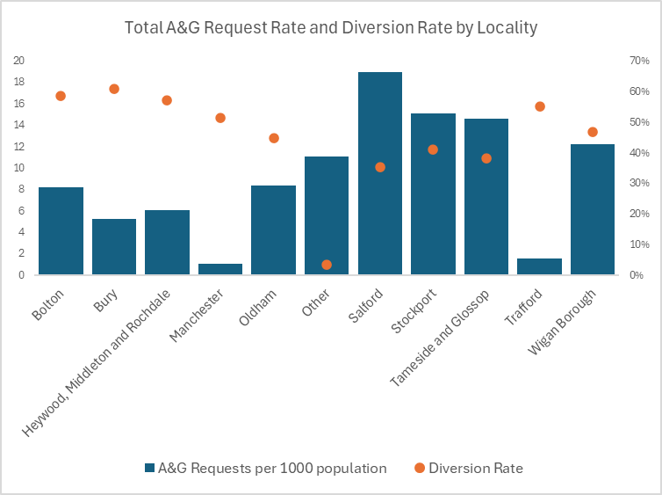
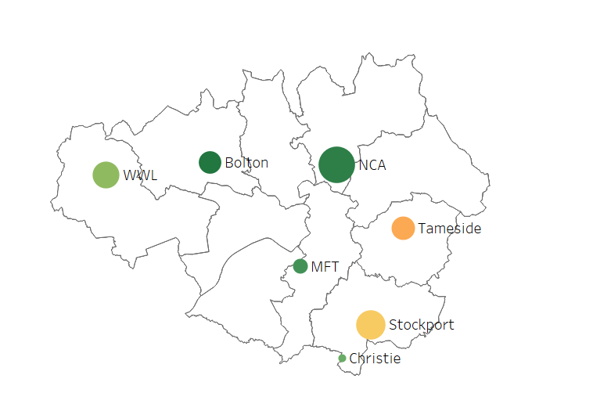
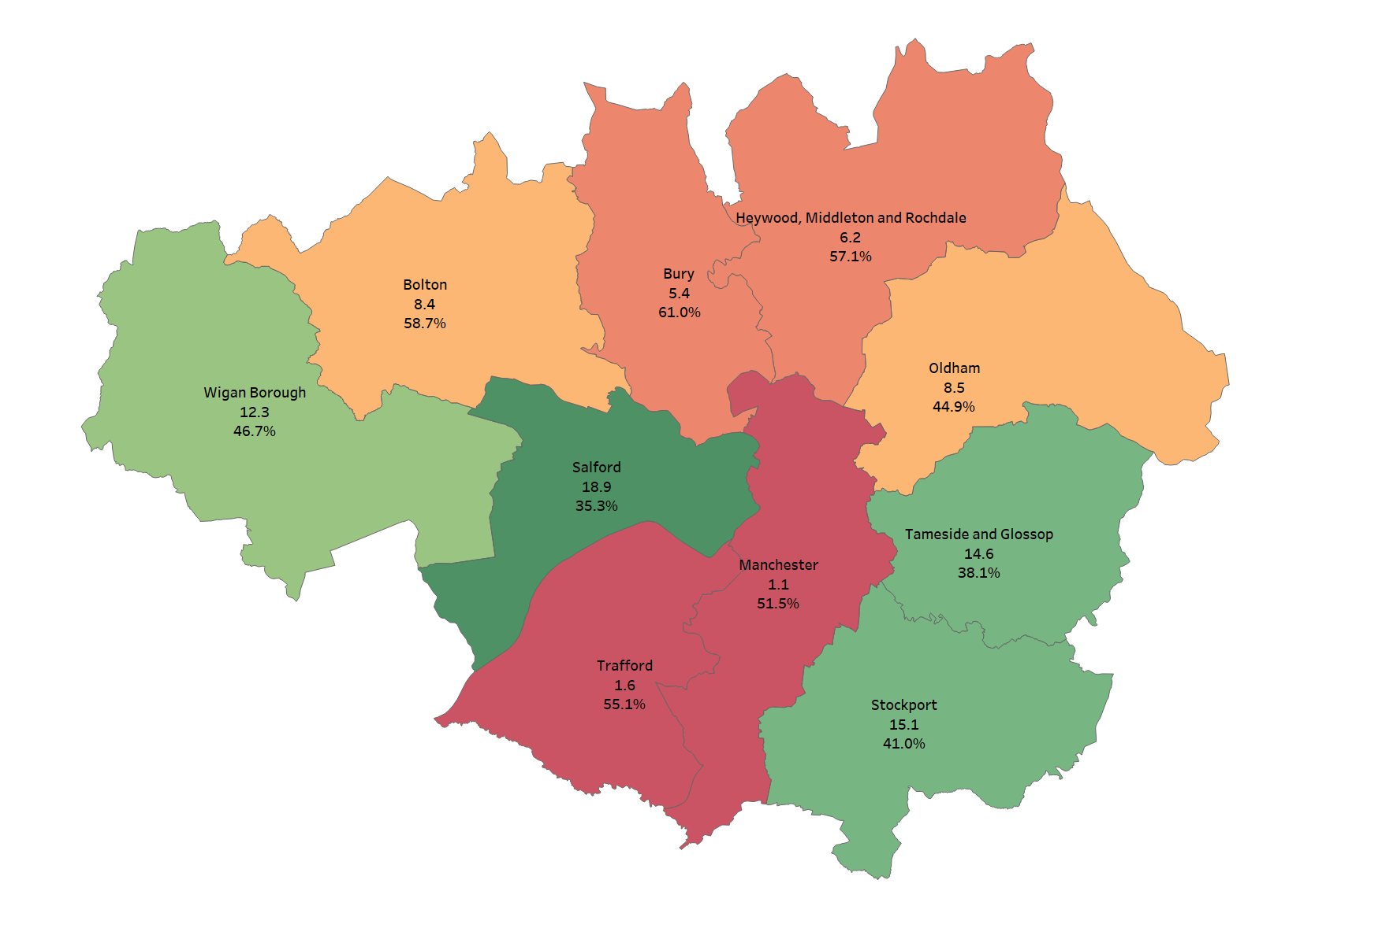
GM Locality Overview
Provider Volume of Requests (size of dot) and Diversion Rate (colour)
A&G Referrals per 1000 pop by Locality

Slide 9
Appendix 1

Slide 10
Highlights
ERS will continue as is. GM are working with the Trusts to improve the current long-term offer for pre-referral A&G via this route.
The £20 DES payment per episode of care for use of pre-referral A&G will be available via either ERS or the use of the new service.
The service will be available to use by all GPs in Greater Manchester via either telephone call (average answer time less than 1 minute) or via a messaging option.
Patient notes will be linked to, and a summary of the consult will be available after the call/message for attaching to patient notes.
There will be c25 specialties available via the national consultant network (currently only 40% coverage of specialties across GM footprint of ERS).
All of the 18 NHSE GIRFT identified priority elective specialties and all of those covered in in the BeCCoR scheme will be available via the national consultant network.
There is no onward referral available by the service to secondary care Trust, a referral needs to be made as it would normally.
By the nature of the service there will not be a long-written response provided by the service post consult. IF this is deemed necessary, then use of the current ERS offer where available should be used.
The national network of consultants will have some local information available to them, but they will not have detailed knowledge of the local service.
The service will follow the current guidelines for pre-referral A&G. The risk will still sit with the GP once A&G has been received. The Consultant is required to provide accurate information.
Notes:
Fast-Track "Change Story" & “What’s In it for me” (WIIFM) for Primary Care:
£20 Enhanced Service Specification payment – for all pre-referral A&G requests per episode of care.
Instant access to pre-referral A&G – can be concurrently when with patient, across wide spectrum of specialties.
Fast turnaround of responses – improved on E-RS
Focus on Time-Saving: Highlight how the platform is faster than E-RS or full referral. Emphasise "get answers faster, manage patients quicker."
Reduced Bureaucracy: Position it as a streamlined, auditable process, cutting down on administrative burden often associated with referrals.
Avoiding Unnecessary Referrals: Show immediate impact on reduced patient visits, follow-ups for rejected referrals, and improved patient experience by keeping care closer to home.
Direct Access to Specialists: Promote the direct line to specialist advice that the platform provides, fostering a sense of expert support.
Case Studies: Prepare very short, relatable anonymized case studies (real or hypothetical) demonstrating a common GP query solved quickly and effectively through the A&G platform, compared to the traditional lengthy process.
How will this make their job easier?
How will it save them time or effort?
How will it improve their daily life or work?
How will it help them achieve their goals?
How will it reduce their stress or frustration?
How will it benefit the people they serve (e.g., patients)?
What new opportunities will it create for them?
Key Messages (Sharp & Punchy for GPs):
"Get specialist advice in minutes/hours not weeks.“
"Save patient appointments, save your time.“
"Your expert answer, just a call/message away."

Slide 11
Highlights – using the service
The quickest way to access the service is via the service app, within the app the user can makes calls, send messages, download pictures. The app is a cloud-based service; therefore, no patient information is stored on the device or within the app. This includes the safe clinical photography feature, PhotoSAF. Photos taken via the app are stored in an IG-secure and GDPR-compliant cloud, not on the device, meaning photos won’t appear on your camera roll or in the recently deleted folder. The photos are automatically sent to your NHS email address.
For those who prefer to use their desktop or cannot access the app, telephone A&G calls can be made via the service in your browser. Clinicians accessing the service in their browser can also send messages for advice, attaching existing files/photos when necessary. Additionally, Telephone A&G can be accessed by calling your surgery’s unique Dial-In Number from any phone. Your Dial-In Number, the specialties you have access to, and their operating hours can be found in your Service Directory.
If using the app on your practice’s Wi-Fi, you will not be charged for making a call or sending a message. However, if using the app on 3G/4G/5G, this will come out of your data allowance.
Patient NHS number is needed - The NHS number is attached to the medico-legal call recordings and photo/message PDFs to assist subsequent retrieval by relevant GP practices and/or hospital teams should it be necessary as a patient identifier. In England, an NHS number is required for the service activity to automatically integrate with primary care records. If no NHS number is input by the primary care clinician, the recordings/PDFs can still be tracked by a date/time reference. If you don’t have access to the patient’s NHS number, you can still initiate an advice query, and NHS numbers can be added retrospectively via your browser.
Why is providing the outcome important? Leaving an outcome allows your commissioning organisation to monitor the effectiveness of the service. The information also supports the addition of new specialties to the service. In England, an outcome left after seeking A&G is required to earn CPD credits and for the service activity to integrate with primary care records. After finishing a call within the app, a menu with outcome options will appear on the screen. Select an outcome from the menu by tapping it.

Slide 12
Highlights – using the service
Will specialists have access to any patient records? Specialists are often away from their desks when they take a call, and you should assume they will not have access to patient records. Any advice given will be based entirely on the information you provide to the specialists via telephone/photo/message.
Can I access call recordings? All calls made via the service are recorded for medico-legal reasons. Call recordings can be accessed via the service in your browser by logging in with your credentials for the app. There is no expiry date for call recordings, so you can go back and listen to previous A&G calls whenever necessary. Please note that calls can only be downloaded within your browser and not via the app.
All users will have an account manager allocated to them from the service that can be contacted directly.
The GM team will be loading all relevant information and links to the service within a central repository that GPs will have access to.

